Slide 1

Geometry
Unit 12, Lesson 3 Solving Problems with Secant and Tangent Segments Volume 2, pg. 242

Slide 2


Benchmark
MA.912.GR.6.1
Solve mathematical and real-world problems involving the length of a secant, tangent, segment, or chord in a given circle.
volume 2, pg. 242

Slide 3
Integrated Mathematical Thinking and Reasoning Standards
MA.K12.MTR.1.1 Actively participate in effortful learning both individually and collectively.
MA.K12.MTR.2.1 Demonstrate understanding by representing problems in multiple ways.
MA.K12.MTR.4.1 Engage in discussions that reflect on the mathematical thinking of self and others.
MA.K12.MTR.5.1 Use patterns and structure to help understand and connect mathematical concepts.
MA.K12.MTR.7.1 Apply mathematics to real-world contexts.
volume 2, pg. 242

Slide 4

Learning Target
I can solve mathematical and real-world problems that involve lengths formed by the intersection of a secant and a tangent segment.
volume 2, pg. 242

Slide 5

Warm-Up
volume 2, pg. 242

Slide 6
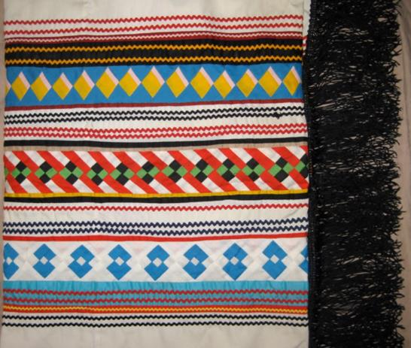
12.3.1 Warm-Up: Notice and Wonder
The Seminole Native American tribe is known for their novel and colorful dress consisting of patchwork. The decorative technique of patchwork was developed by Seminole women before 1920. Patchwork was rapidly adopted to further embellish the already colorful clothing. As time went on, the designs became more intricate as the seamstresses became more skilled.
What do you notice about the patchwork?
What do you wonder?
volume 2, pg. 242

Slide 7

Exploration
volume 2, pg. 243

Slide 8

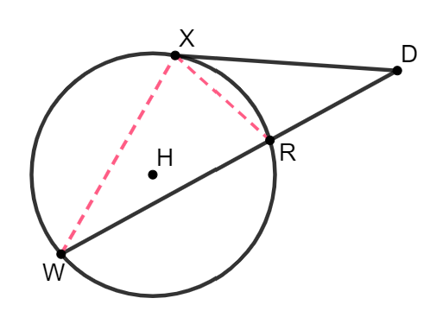
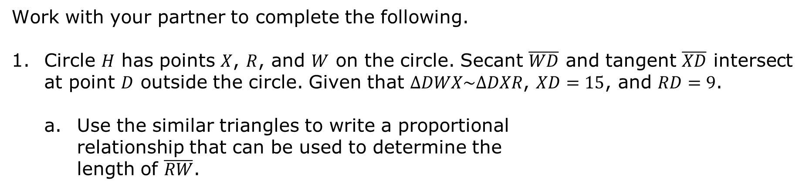
12.3.2 Exploration: Lengths of Intersecting Secant and Tangent Segments
Work with your partner to complete the following.
Circle $H$ has points $X$, $R$, and $W$ on the circle. Secant $\overline{WD}$ and tangent $\overline{XD}$ intersect at point $D$ outside the circle. Given that $∆DWX\sim ∆DXR$, $XD=15$, and $RD=9$.
Use the similar triangles to write a proportional relationship that can be used to determine the
length of $\overline{RW}$.
volume 2, pg. 243

Slide 9
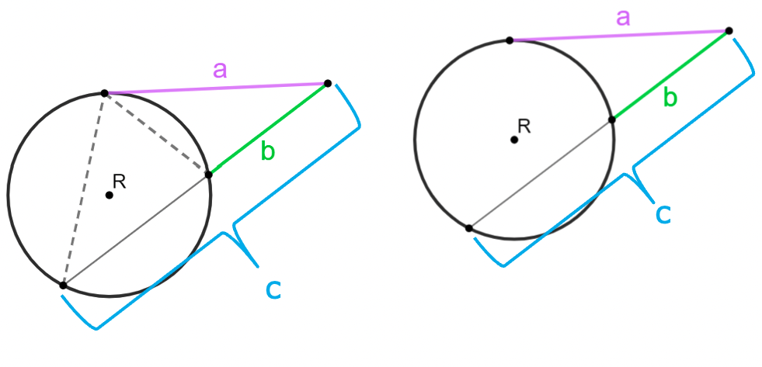

Use the diagrams of circle $R$ to write a formula that can be used to find the segment lengths of the intersecting secant and tangent lines.
If a secant and tangent segment are drawn to a circle from the same external point, then the square of the measure of the tangent segment is equal to the product of the measures of the secant segment and its external secant segment.
volume 2, pg. 243

Slide 10

Guided Practice
volume 2, pg. 244

Slide 11

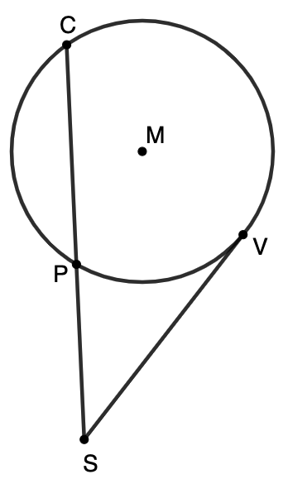
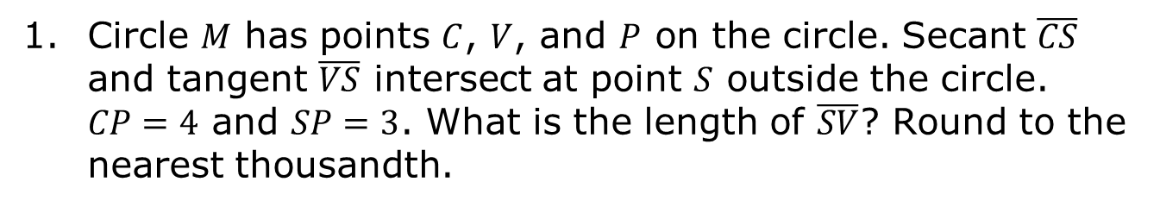
12.3.3 Guided Practice: Solving Problems Involving Intersecting Secant and Tangent Segments
Circle $M$ has points $C$, $V$, and $P$ on the circle. Secant $\overline{CS}$ and tangent $\overline{VS}$ intersect at point $S$ outside the circle.
$CP=4$ and $SP=3$. What is the length of $\overline{SV}$? Round to the nearest thousandth.
volume 2, pg. 244

Slide 12
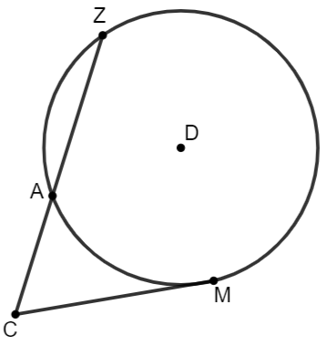
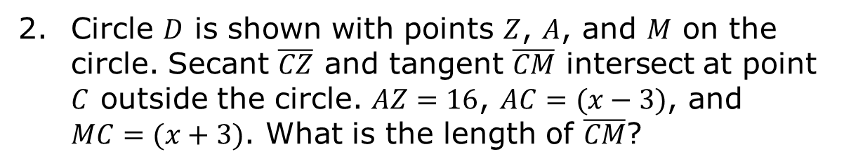
Circle $D$ is shown with points $Z$, $A$, and $M$ on the circle. Secant $\overline{CZ}$ and tangent $\overline{CM}$ intersect at point $C$ outside the circle. $AZ=16$, $AC=(x−3)$, and $MC=(x+3)$. What is the length of $\overline{CM}$?
volume 2, pg. 244

Slide 13
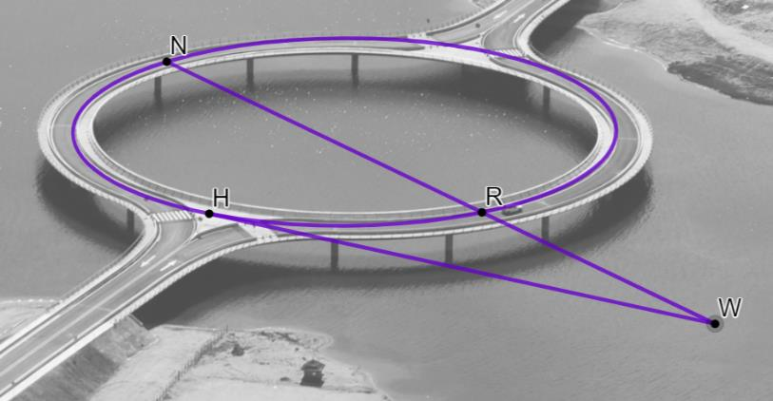
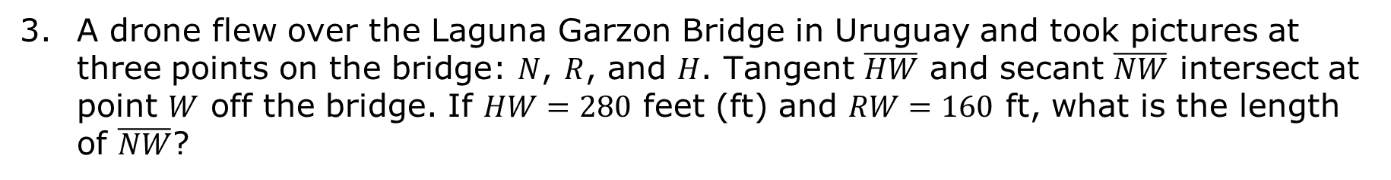
A drone flew over the Laguna Garzon Bridge in Uruguay and took pictures at three points on the bridge: $N$, $R$, and $H$. Tangent $\overline{HW}$ and secant $\overline{NW}$ intersect at point $W$ off the bridge. If $HW=280$ feet (ft) and $RW=160$ ft, what is the length of $\overline{NW}$?
volume 2, pg. 244

Slide 14

Your Turn
volume 2, pg. 245

Slide 15
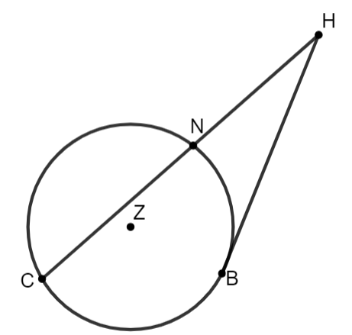
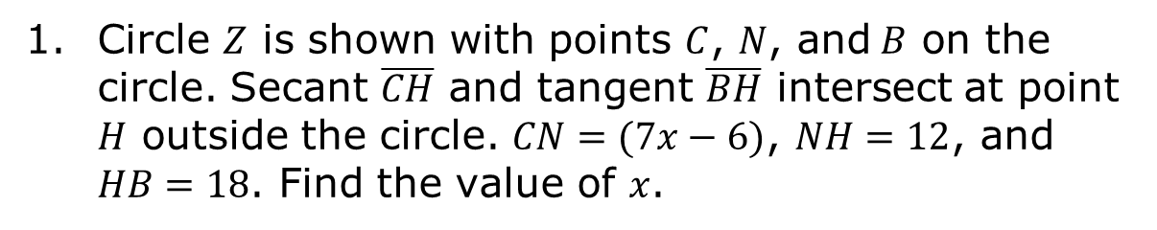
12.3.4 Your Turn!
Circle $Z$ is shown with points $C$, $N$, and$B$ on the circle. Secant $\overline{CH}$ and tangent $\overline{BH}$ intersect at point $H$ outside the circle. $CN=(7x−6)$, $NH=12$, and $HB=18$. Find the value of $x$.
volume 2, pg. 245

Slide 16
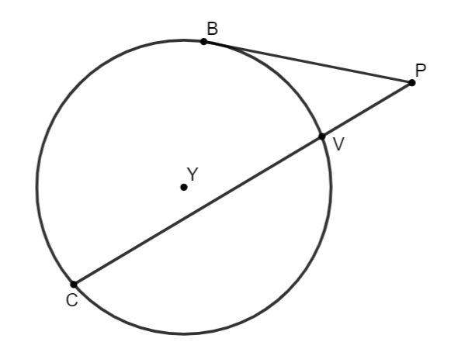
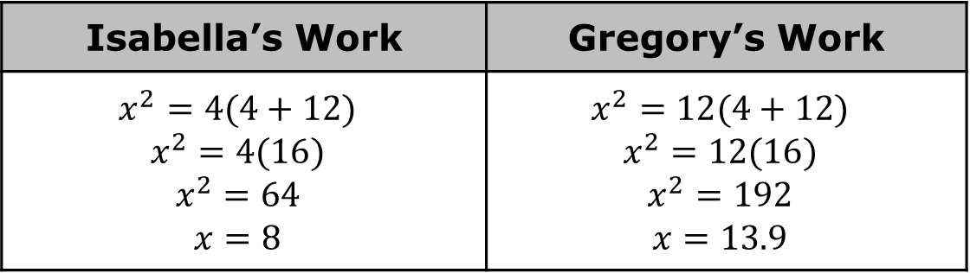
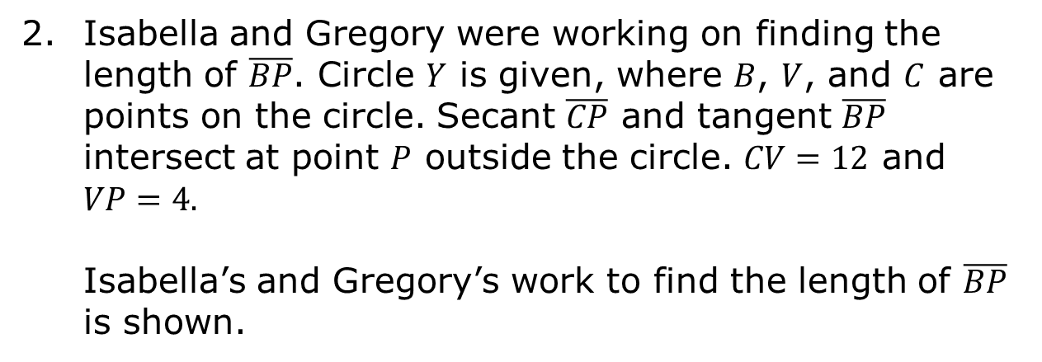
Isabella and Gregory were working on finding the length of $\overline{BP}$. Circle $Y$ is given, where $B$, $V$, and $C$ are points on the circle. Secant $\overline{CP}$ and tangent $\overline{BP}$ intersect at point $P$ outside the circle. $CV=12$ and $VP=4.$
Isabella’s and Gregory’s work to find the length of $\overline{BP}$ is shown.
Isabella’s Work | Gregory’s Work
$$x^{2}=4(4+12)$$ $$x^{2}=4(16)$$ $$x^{2}=64$$ $$x=8$$ | $$x^{2}=12(4+12)$$ $$x^{2}=12(16)$$ $$x^{2}=192$$ $$x=13.9$$
volume 2, pg. 245

Slide 17
Whose work do you agree with?
Write a note to the person whose work is incorrect explaining their mistake.
volume 2, pg. 245

Slide 18

Wrap-Up
volume 2, pg. 246

Slide 19
12.3.5 Wrap-Up: Cool Down
Write a summary of what you learned in this lesson.
volume 2, pg. 246

